Slide 1
Vector Algebra
Vikith 240970107

Slide 2
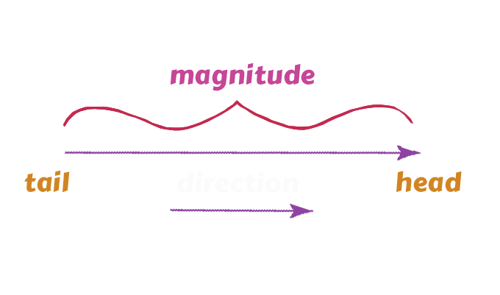
What is Vector?
A vector is a quantity which has both
magnitude and direction
For example : velocity,
displacement, acceleration,
force are all vector quantities that
have a magnitude as well as a direction.

Slide 3
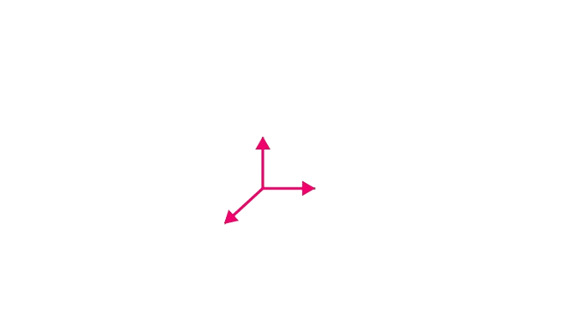

How To Representat Vectors ?
Vector A⃗ can be expressed
in Cartesian coordinates as:
where a, b, and c are real numbers representing the components along the x, y, and z axes, respectively.

Slide 4
Types of vectors?
Zero Vector
Unit Vector
Equal Vector
Position Vector
Co-initial Vector
Collinear Vector

Slide 5
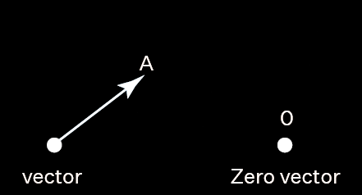
Zero Vectors
Vectors that have 0 magnitude and
no direction.are called
zero vectors.
Unit Vectors
Vectors that have magnitude
equals to 1 are called unit
vectors, denoted by ^a.

Slide 6


Co-initial Vectors
Two or more vectors are said to
be co-initial if they have the same
starting point, or origin.
Collinear Vectors
Two or more vectors are said to
be collinear if they lie along the same
line or parallel lines.

Slide 7


Position Vectors
A position vector is a vector that
represents the position of a point in
space relative to a fixed origin.
Equal Vectors
Vectors with the same magnitude and direction.

Slide 8
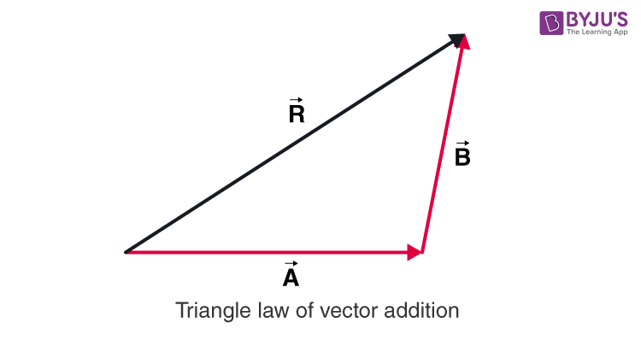
Triangle Law of Addition of Vectors: The law states that if two sides of a triangle represent the two vectors (both in magnitude and direction) acting simultaneously on a body in the same order, then the third side of the triangle represents the resultant vector.

Slide 9


Adding two vectors
Suppose we have two vectors:
The sum of the two vectors,

Slide 10

Example :

Slide 11
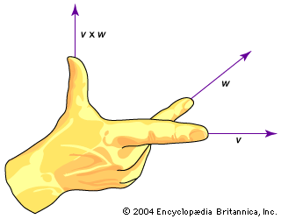
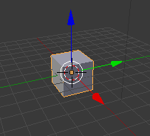
Applications across various fields
Physics and Engineering
Forces and Motion: Vectors help represent forces acting on an object, making it possible to calculate resultant forces, displacements, and velocities.
Computer Graphics and Game Development
3D Modeling: Vector algebra is used to manipulate and transform objects in 3D space, including rotation, scaling, and translation.

Slide 12
Thank You

